Slide 1
SQL Database Project
Query Execution, ERD & Documentation
Submitted by: Jaskirat Athwal
Student ID: 101001605
Submitted to: Praveen Raju Gunasekaran

Slide 2
Project Overview
Database creation Online Store
Create tables
Customers
Product
Orders
Inventory
Reviews
Entity-relationship Diagram
Queries

Slide 3
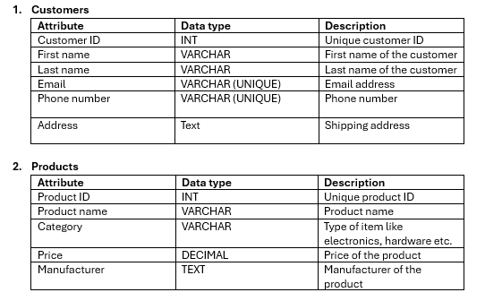
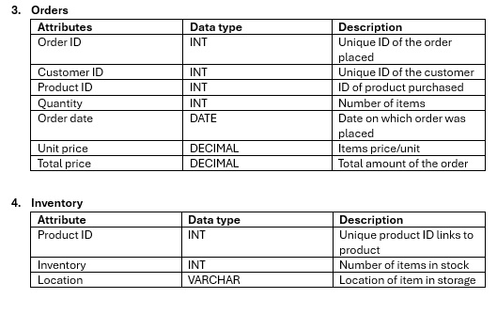
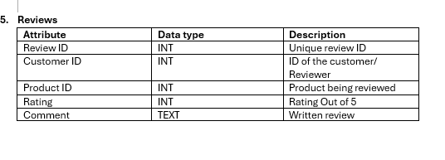
Table and Attributes

Slide 4
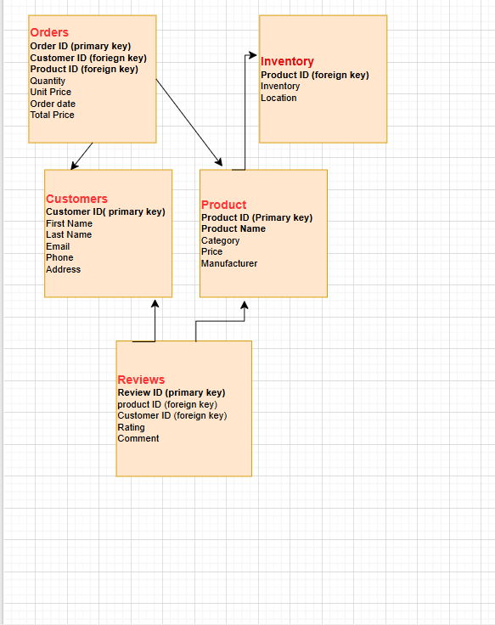
Entity-relationship Diagram

Slide 5
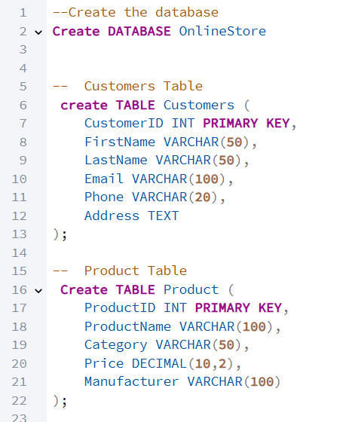
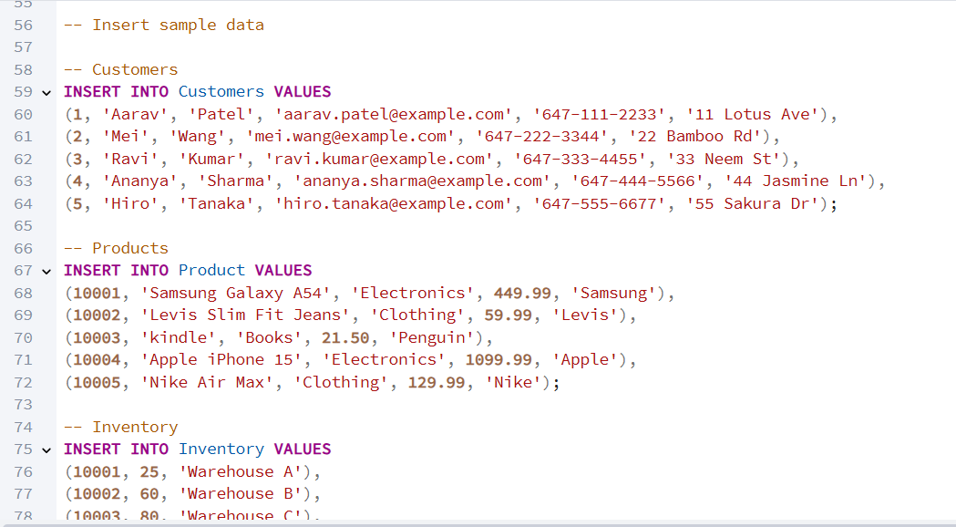
SQL Script

Slide 6
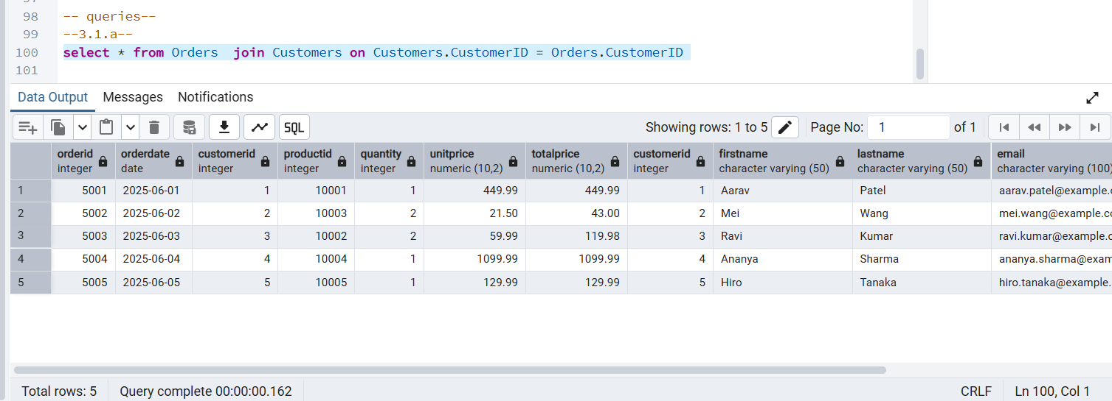
Queries
3.1.a A query to check if all orders are associated with existing customers.

Slide 7
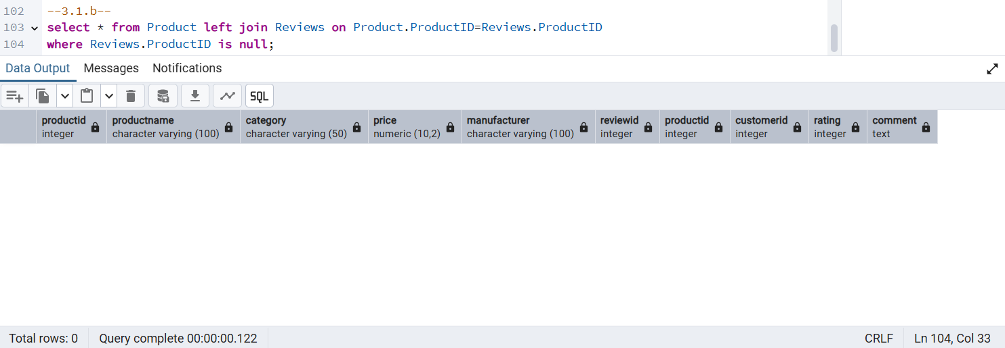
3.1.b A query to find products that have not been reviewed.

Slide 8
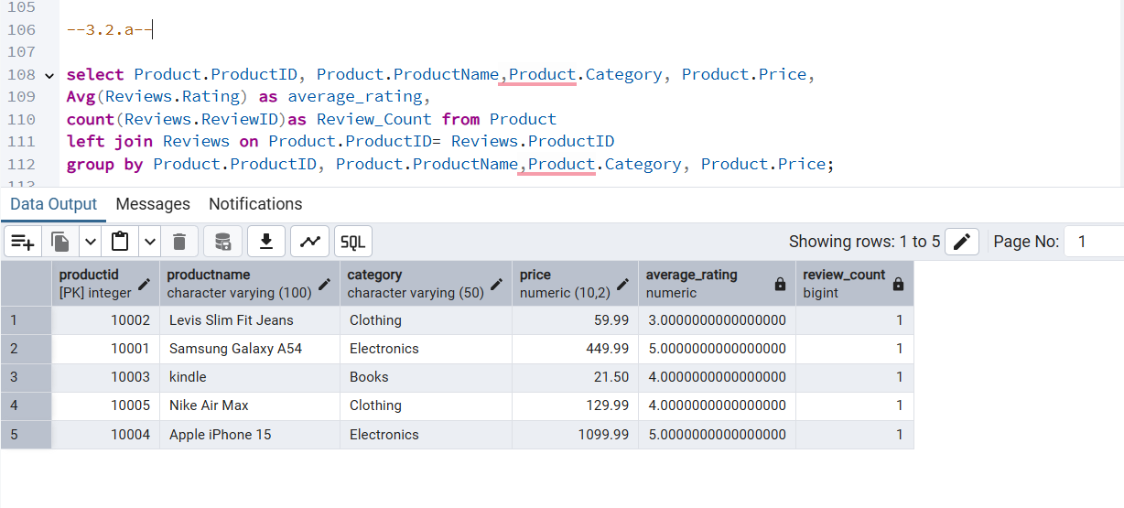
3.2.a A view to show all products and their average ratings.

Slide 9
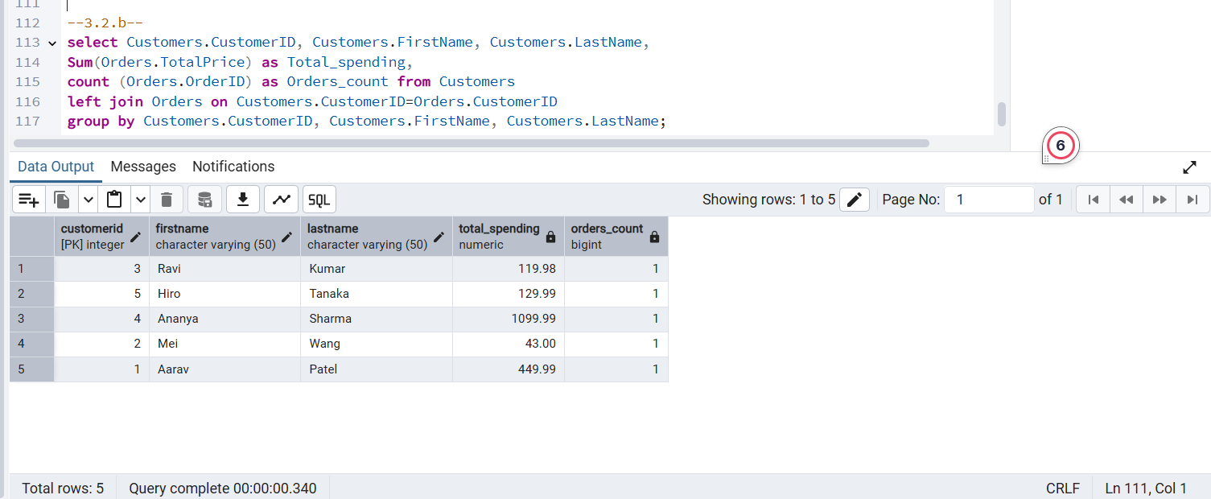
3.2.b A view to show customer details along with their total spending.

